Slide 1
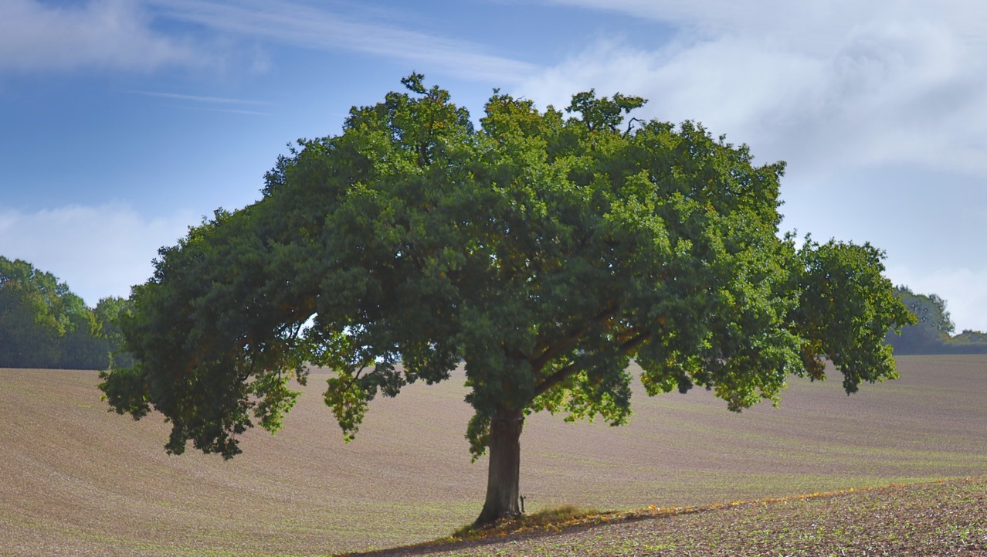

Long Sutton & Well Parish Council Annual Parish Assembly April 2026 Jim Goodbourn Parish Council Chair

Slide 2
Agenda
Introductory remarks & your PC Team
Planning
Highways, Village Maintenance and Infrastructure
Challenges and Intent for 26/27
Public Questions and Comments

Slide 3
Your PC Team
Myself as Chair and responsible for LWC liaison
Roger Bright - Planning
Frazer Hamilton – Footpaths, SID, Planning Support
Mark Bartlett – Highways, Lengthsman, Planning Support
Karen Thornton – Primary School liaison, OGCC liaison, Recreation Ground
Susan Richardson – Clerk & Responsible Finance Officer

Slide 4
Overview of Planning
Routine other than the following key issues

Slide 5

Solar Farm
PA 24/-2591/FUL (revised) APPROVED by HDC in April 2025.
Meeting took place with Alex Brewer in May with little material result
Follow up meetings with District Councillors have continued throughout 25/26 with again no material result
PA 25/01007/FUL installation of underground grid connection cable. Approved by HDC despite significant material effects on local roads and traffic
Actions: The PC will aim to manage the situation as best it can by engaging with the developer BayWa r.e

Slide 6
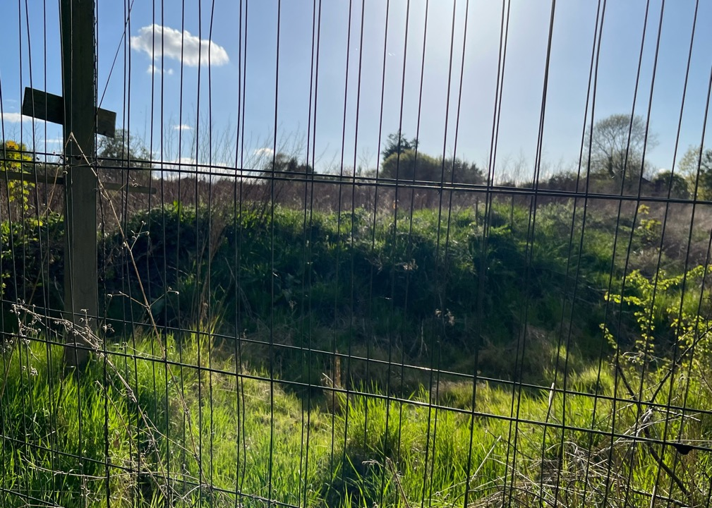
Big Meadow
Proactive engagement with both Allsop and Hart Senior Management Team.
Primary issues:
S106 monies outstanding with Hart who retain a charge on one of the unsold houses
Landscape approval in place and cost of soil removal
State of sewage system drainage
Actions: Monthly engagement with HDC Team as they continue to liaise with Allsop.

Slide 7
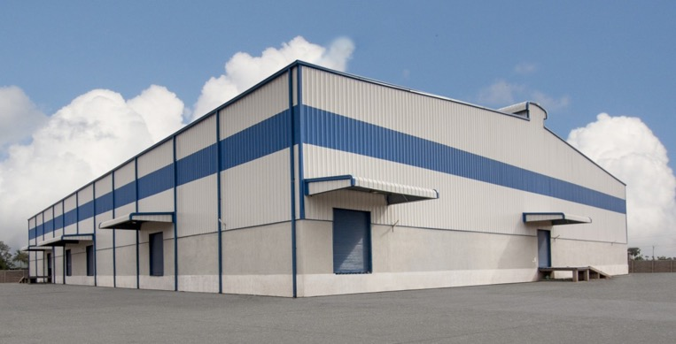
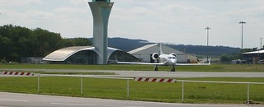
Other main issues
Lodge Farm Warehouse application (M3 J5)
Pre-app submitted
HDC opinion issued
Appears to be on hold pending applicant intent
Farnborough Airport increased aircraft movements
Updated planning application was submitted with little material change
Parish objected along with others
Decision still awaited
This Photo by Unknown Author is licensed under CC BY

Slide 8
Overview of Highways, Village Maintenance, Infrastructure and Events

Slide 9
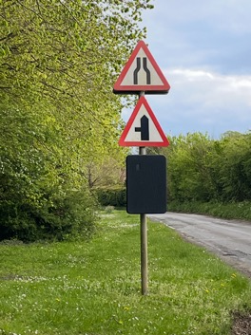
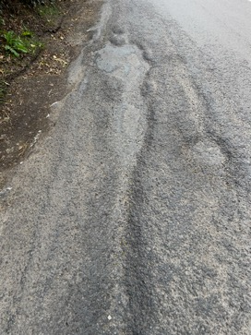
Village Roads
Considerable work on speed management in the village has focused on:
SID data - The SIDs have been moved around a few locations to capture speeds at key points.
Working with LWC to encourage more acceptable driving speeds and styles
Introduction of a 20 mph speed limit zone - a feasibility report has been obtained. However, costs for introduction could be circa £60-80K versus the likely success of imposition on road users
Potholes a still real issue – temporary patching only
The wetter than usual winter months have seen significant pothole damage across the UK
Since the New Year, Hampshire Highways are exceeding their target completion dates for pothole repairs

Slide 10
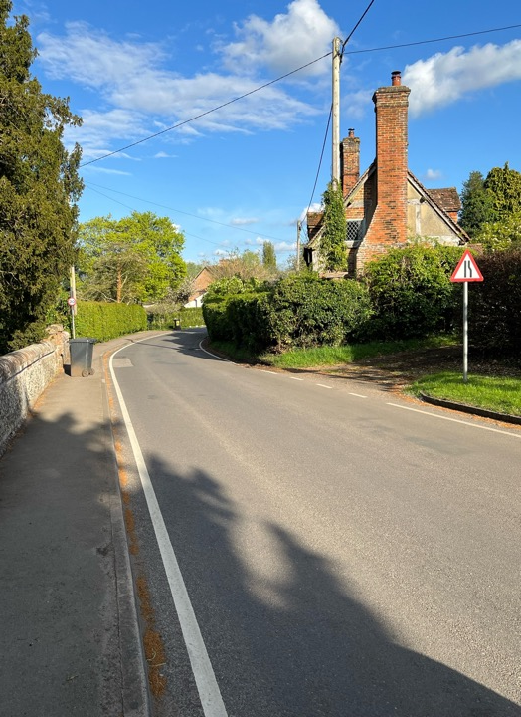
Maintenance of the Village Fabric
The Lengthsman service continues to assist with parish maintenance albeit only part funded by Hampshire CC at £1,000 per annum.
Tasks completed include:
Clearing the roadside drainage ‘grips
Emptying the silt traps at the pond,
Removing storm damaged trees, bushes and debris to the green waste site,
Mowing the pond area, strimming at Well and at the recreation ground.
An annual clean of all the traffic signs throughout the village.
The Lengthsman service will continue through 2026/27

Slide 11
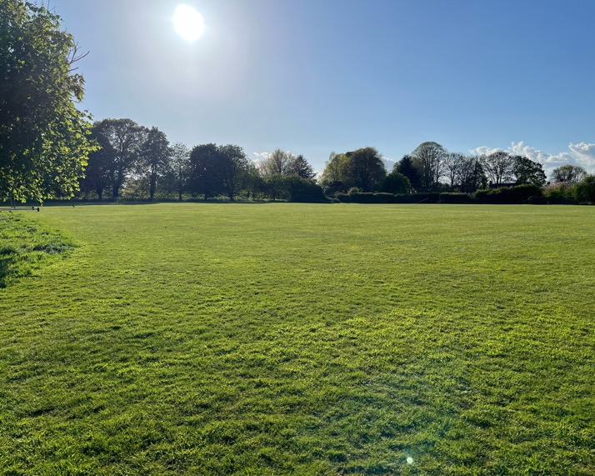
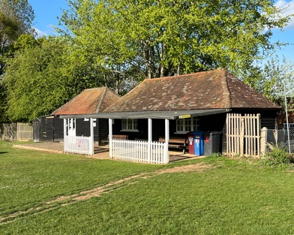
The Pavilion and Recreation Ground
Primarily in support of Village cricket (OGCC) considerable effort and expenditure to improve the standard of the pavilion has continued
The costs of the pavilion are the highest single cost to the PC
Vandalism at the pavilion has been a significant issue
The Recreation Ground has been well maintained throughout by:
The Lengthsman
OGCC maintenance and LWC grass cutting
Parish Council funded grass cutting outside of the cricket season
The playground and Zip wire continue to be maintained by the Parish Council

Slide 12
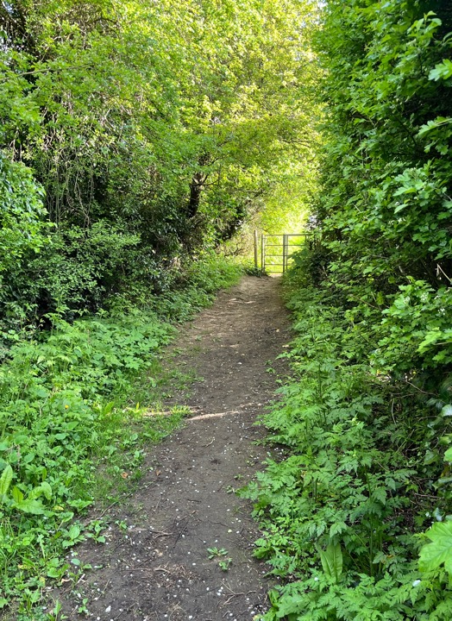
Footpaths
Considerable and continuing maintenance effort
As users we also have responsibilities ensuring that dogs are kept under control on the footpaths and waste removed
We have been joined by two very capable assistants walking around our footpaths, James Burton Stewart and Nick Brown
Nick has actively cleared fallen trees on FP3 and is always ready with his cutters in dealing with those overgrown branches
Please be aware of the revised dog walking law which can result in unlimited fines to the dog owner where dogs are allowed to attack or stress livestock.
ALL DOGS MUST REMAIN ON A LEAD NEAR LIVESTOCK

Slide 13
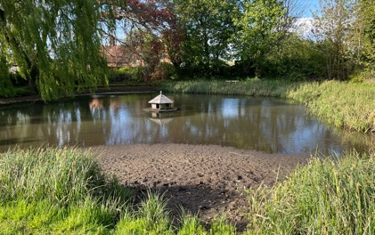
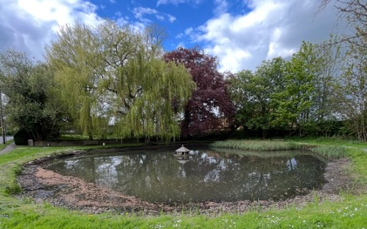
The Village Pond
Before
Great work by a volunteer working party led by Richard Nichols to improve the sorry state of village pond following a very dry summer
Specific tasks completed include:
Silt traps were thoroughly cleared
The bulk of the reeds and silt beach that were exposed above water level have been removed
The pond has fared well over the winter months with ongoing planned maintenance this year
Our thanks to Mark Humphries at Topsoil, who kindly arranged grab lorry removal and disposal at reduced cost funded by the Parish Council
The results can be clearly seen………….
After

Slide 14


Lord Wandsworth College and Long Sutton Primary School
LWC
LWC make a significant contribution to Village Life which includes but not limited to:
Traffic speed
Reminders to parents re speed through the village
Provision of funding for a SID
Material support to other traffic calming measures (eg. Signage)
Provision of the Recreation Ground for a peppercorn rent
Support to the Annual Church Remembrance Service
Volunteer groups of students to undertake remediation projects in the Village
The Primary School
We maintain a close liaison with the Primary School and provide:
Free access and use of the Recreation Ground including:
The playground
Use of the Ground and the Pavilion for summer sports including the annual Sports Day

Slide 15
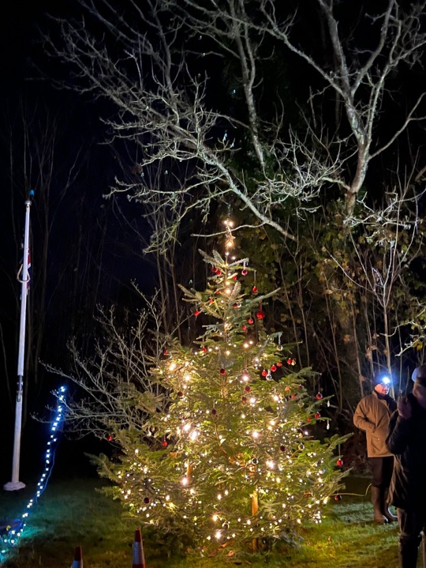
Christmas Tree Lighting & Carols
A popular annual event hosted by the Parish Council
Our thanks to:
The Wildsmith’s for once again supplying the tree
The Eyre-Walkers for providing the facilities in support of Father Christmas and his band of merry men aka Pete Spreadborough and Andy Trimmer
The Primary School Choir for their excellent carol singing

Slide 16
Challenges and Projects for 26/27

Slide 17
Proposed Car Rally Time Trial Apr 2027 – Dimanche Tour, Farnborough Motor Club
This has been imposed on the Long Sutton & Well Parish and will have material effects on directly affected residents and increase traffic flows across a weekend
In accordance with comments and concerns received from the community combined with the effects of Solar Farm mobilization, the Parish Council has objected to the event via the following
The organisers
Hart DC
Highways
Hampshire Police
LWC (who are providing Rally Headquarters)
Follow up objection action will continue

Slide 18

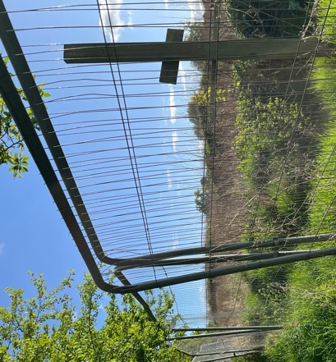
Planning Challenges – these will persist throughout 2026/27
Solar Farm
We will seek a major financial payment from the developer as compensation to the community for likely disruption and general effects of the solar farm
We will manage the mobilization – to note, no contact with the developer has been achieved despite our requesting it directly to the developer and also indirectly through Hart
Big Meadow
Priorities are to
Protect the interests of residents
Continue to lobby Hart to resolve
Negotiate with Allsop and Hart to achieve an acceptable outcome
Complete planning process
Hart is amending its local plan in response to additional land required by central Government for housing. This has some implications:
Until there is a new local plan then planning approval is tilted towards supporting applications for housing development. This situation will persist until the Plan is completed in 2028
As part of this process Hart has issued a ‘call for sites’ for housing development – this action is usually time limited but is now open indefinitely, which sends a clear message to landowners and developers
The re-organisation of local government in 2028 will affect the delivery of the local plan as it will fall to the new unitary authority
This Photo by Unknown Author is licensed under CC BY-NC

Slide 19
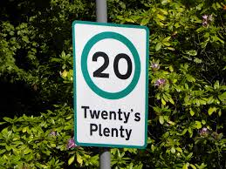
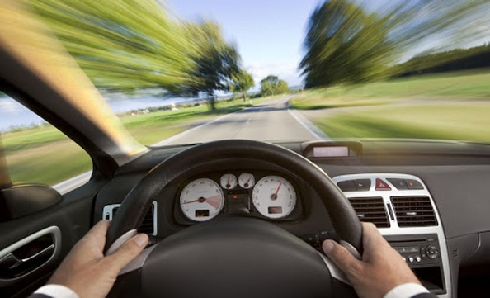
Traffic Calming
A great aid to speed management for our community is to drive at the most suitable speeds in our village and around our community.
We would suggest:
20 mph through the Village
40 mph on Hayley Lane
Material actions planned for this year include:
Work with LWC to encourage parents to observe speed limits and drive responsibly
Re-do white centre lines on Hayley Lane which has been included within the Hampshire Highways budget for this year
Potentially Introduce 20 is plenty signage
We now have two types of SID (the second purchased by LWC) – first one after 9 years of use is near replacement at significant cost

Slide 20
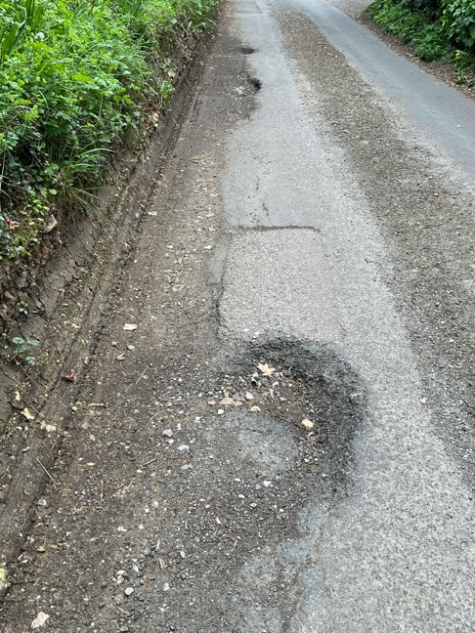
Highways
Potholes will remain a real issue – lack of funding will result in temporary patching only
Traffic challenges through the Village causing road damage will continue despite every effort to control it. Further damage to road fabric will likely result
We are also aware of safety implications as a result of blown out tyres and cars being forced into the middle of the road
Please continue to report potholes to Hampshire Highways and/or Fix my street:
https://www.fixmystreet.com

Slide 21
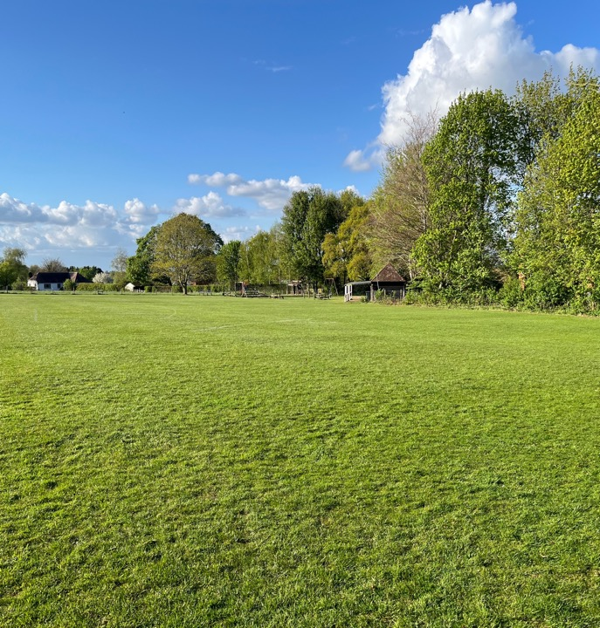
Budget and Cost challenges
Brought forward from 25/26 £19,361.10
Budget 26/27 Running costs without projects - £20,323.00
Precept £28,045.00
Earmarked Reserves
Pavilion roof - £10,000
Traffic Calming - £8,000
Pond Maintenance - £1,000
Playground - £2,500
General Reserves we must hold £5,583.10

Slide 22
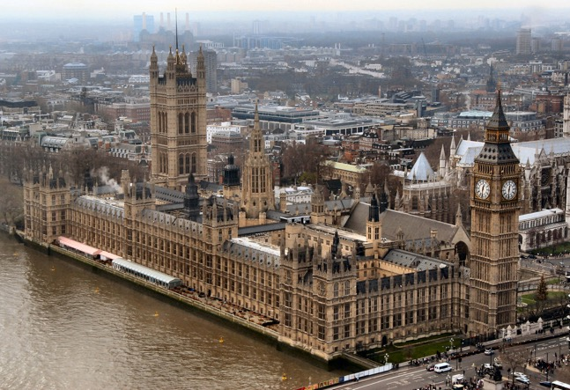
Local Government transformation
The local government reorganisation in 2028 remains on track
The Secretary of State has confirmed his decision to proceed with a five‑unitary model for Hampshire, the Isle of Wight, Portsmouth and Southampton
For Hart, this means that the proposal to form a North Hampshire unitary authority (with Basingstoke & Deane and Rushmoor) will now move forward, subject to the necessary legislation being approved by Parliament.
Implications for Parish Councils and communities remains unclear.

Slide 23

Changes to your Parish Council
After a combined 20 plus years of service on the Parish Council, we say farewell and our warmest thanks and admiration to Councillors Mark Bartlett and Roger Bright
Mark, Roger - our many thanks on behalf of our community – we are indebted to you
Councillor Karen Thornton joined the Parish Council via co-option in September 2025. Very active in the community; a Trustee on the Village Hall Committee and involved with the Summer Fete Committees
I am also pleased to confirm that we have an uncontested local election for Councillors myself, Karen Thornton and Fraser Hamilton and also the addition of James Burton-Stewart who was newly elected to the Parish Council and will take his place at our first meeting of the Council year on 13 May
We will still have one vacancy on the Parish Council and this will be advertised to the community after the 13 May meeting. This vacancy will again be filled by co-option

Slide 24
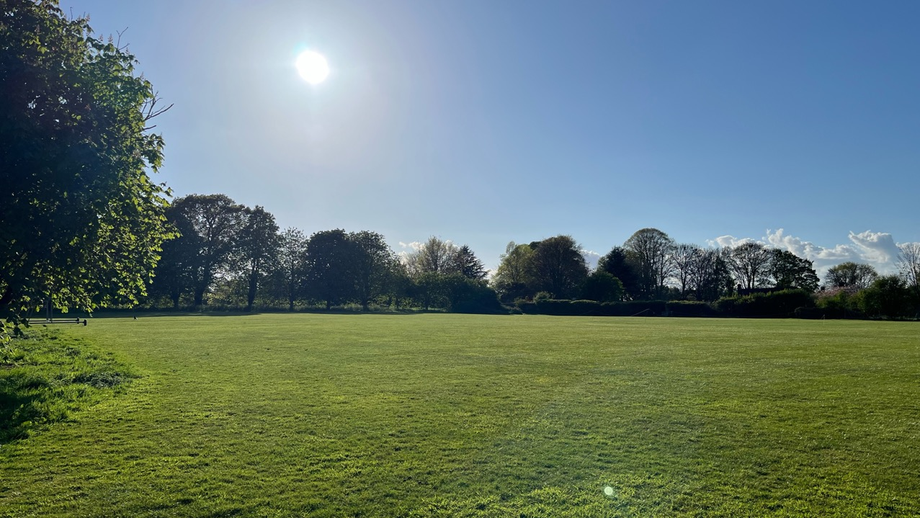
Questions or Comments

